Slide 1
PHS RShiny Dashboard Project
Team Klas

Slide 2
The plan
The team
The problem
The brief
The questions
The project
The tools
The shiny app
The end
Notes:
This is what we are going to talk about today – this is the plan
The team – who are we
The problem – what are we looking at
The brief – what have we been asked to do
The questions – what questions are we specifically looking at
The project – how did we plan and operate
The shiny app – a look at what we made
The end – and an opportunity to ask questions

Slide 3
The Team
Kang Hin Lee
Lucy Burns
Aboubakar Hameed
Seàn Cusick
TEAM KLAS
Notes:
This is what we are going to talk about today – this is the plan
The team – who are we
The problem – what are we looking at
The brief – what have we been asked to do
The questions – what questions are we specifically looking at
The project – how did we plan and operate
The shiny app – a look at what we made
The end – and an opportunity to ask questions

Slide 4
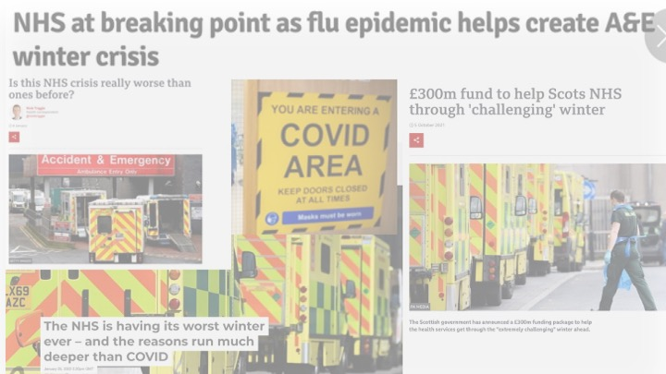
The NHS is in Crisis
Notes:
The Problem
The NHS is in crisis – or so we are led to believe.

Slide 5
The Brief
Create a dashboard using R-Shiny and PHS open data on secondary care to investigate what has been happening from 2020 onwards in the acute hospital sector

Slide 6
Questions
How does Covid affect hospital activity?
How does winter affect hospital activity? A&E/Department activity/ by time
Was there a change post Q1 2020?

Slide 7
The Project
Methodology
Planning
Datasets
Wrangling
Analysing
Shiny-ing
Conclusions

Slide 8
The Tools
Discord
tidyverse
RStudio
Codeclan
GitHub
Shiny
ggplot

Slide 9
The Data
The Aim: Efficiency and Consistency
Extract
Cleaning
Wrangling

Slide 10

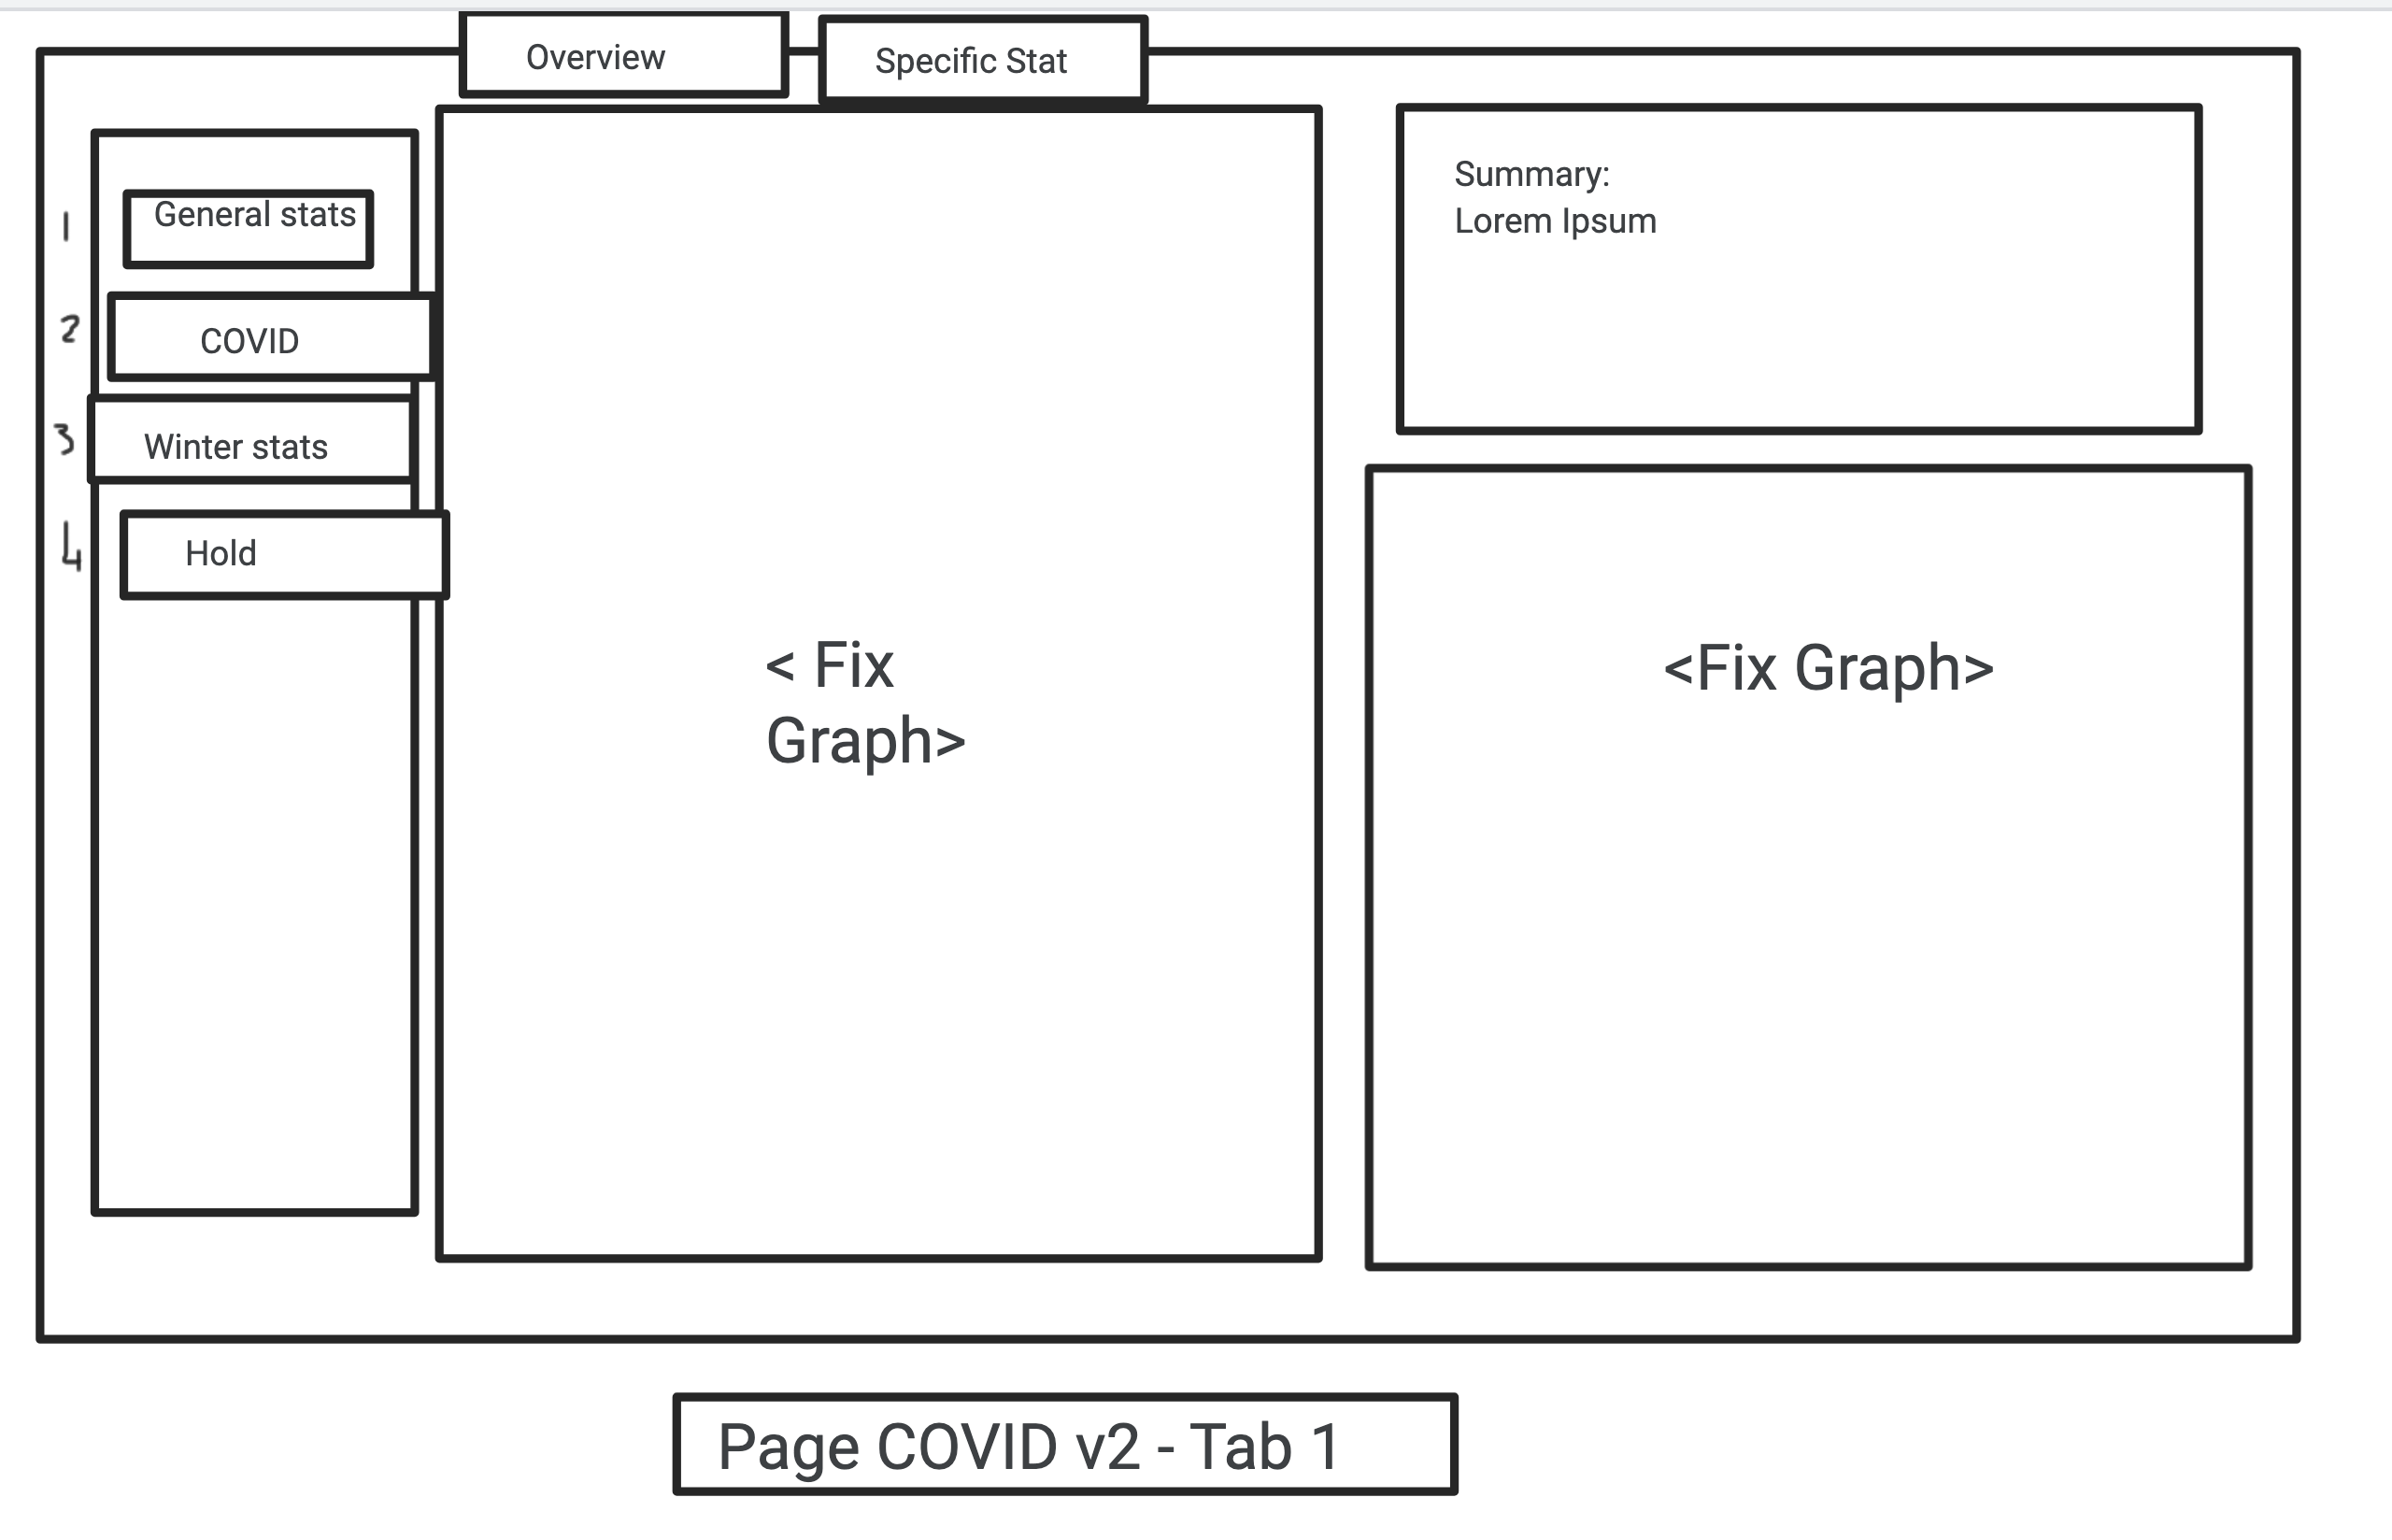
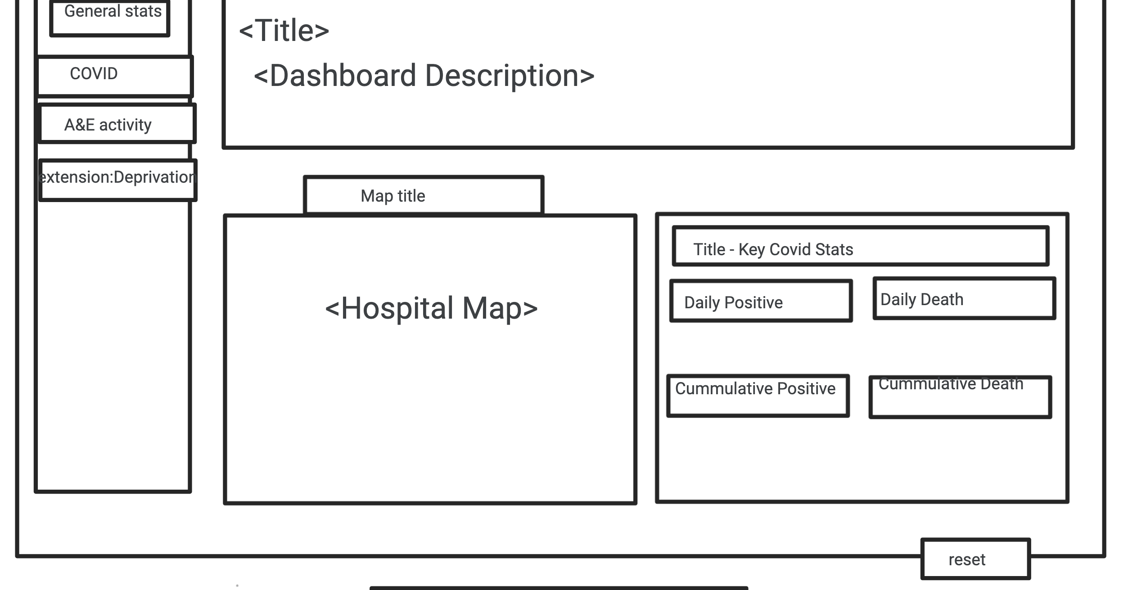
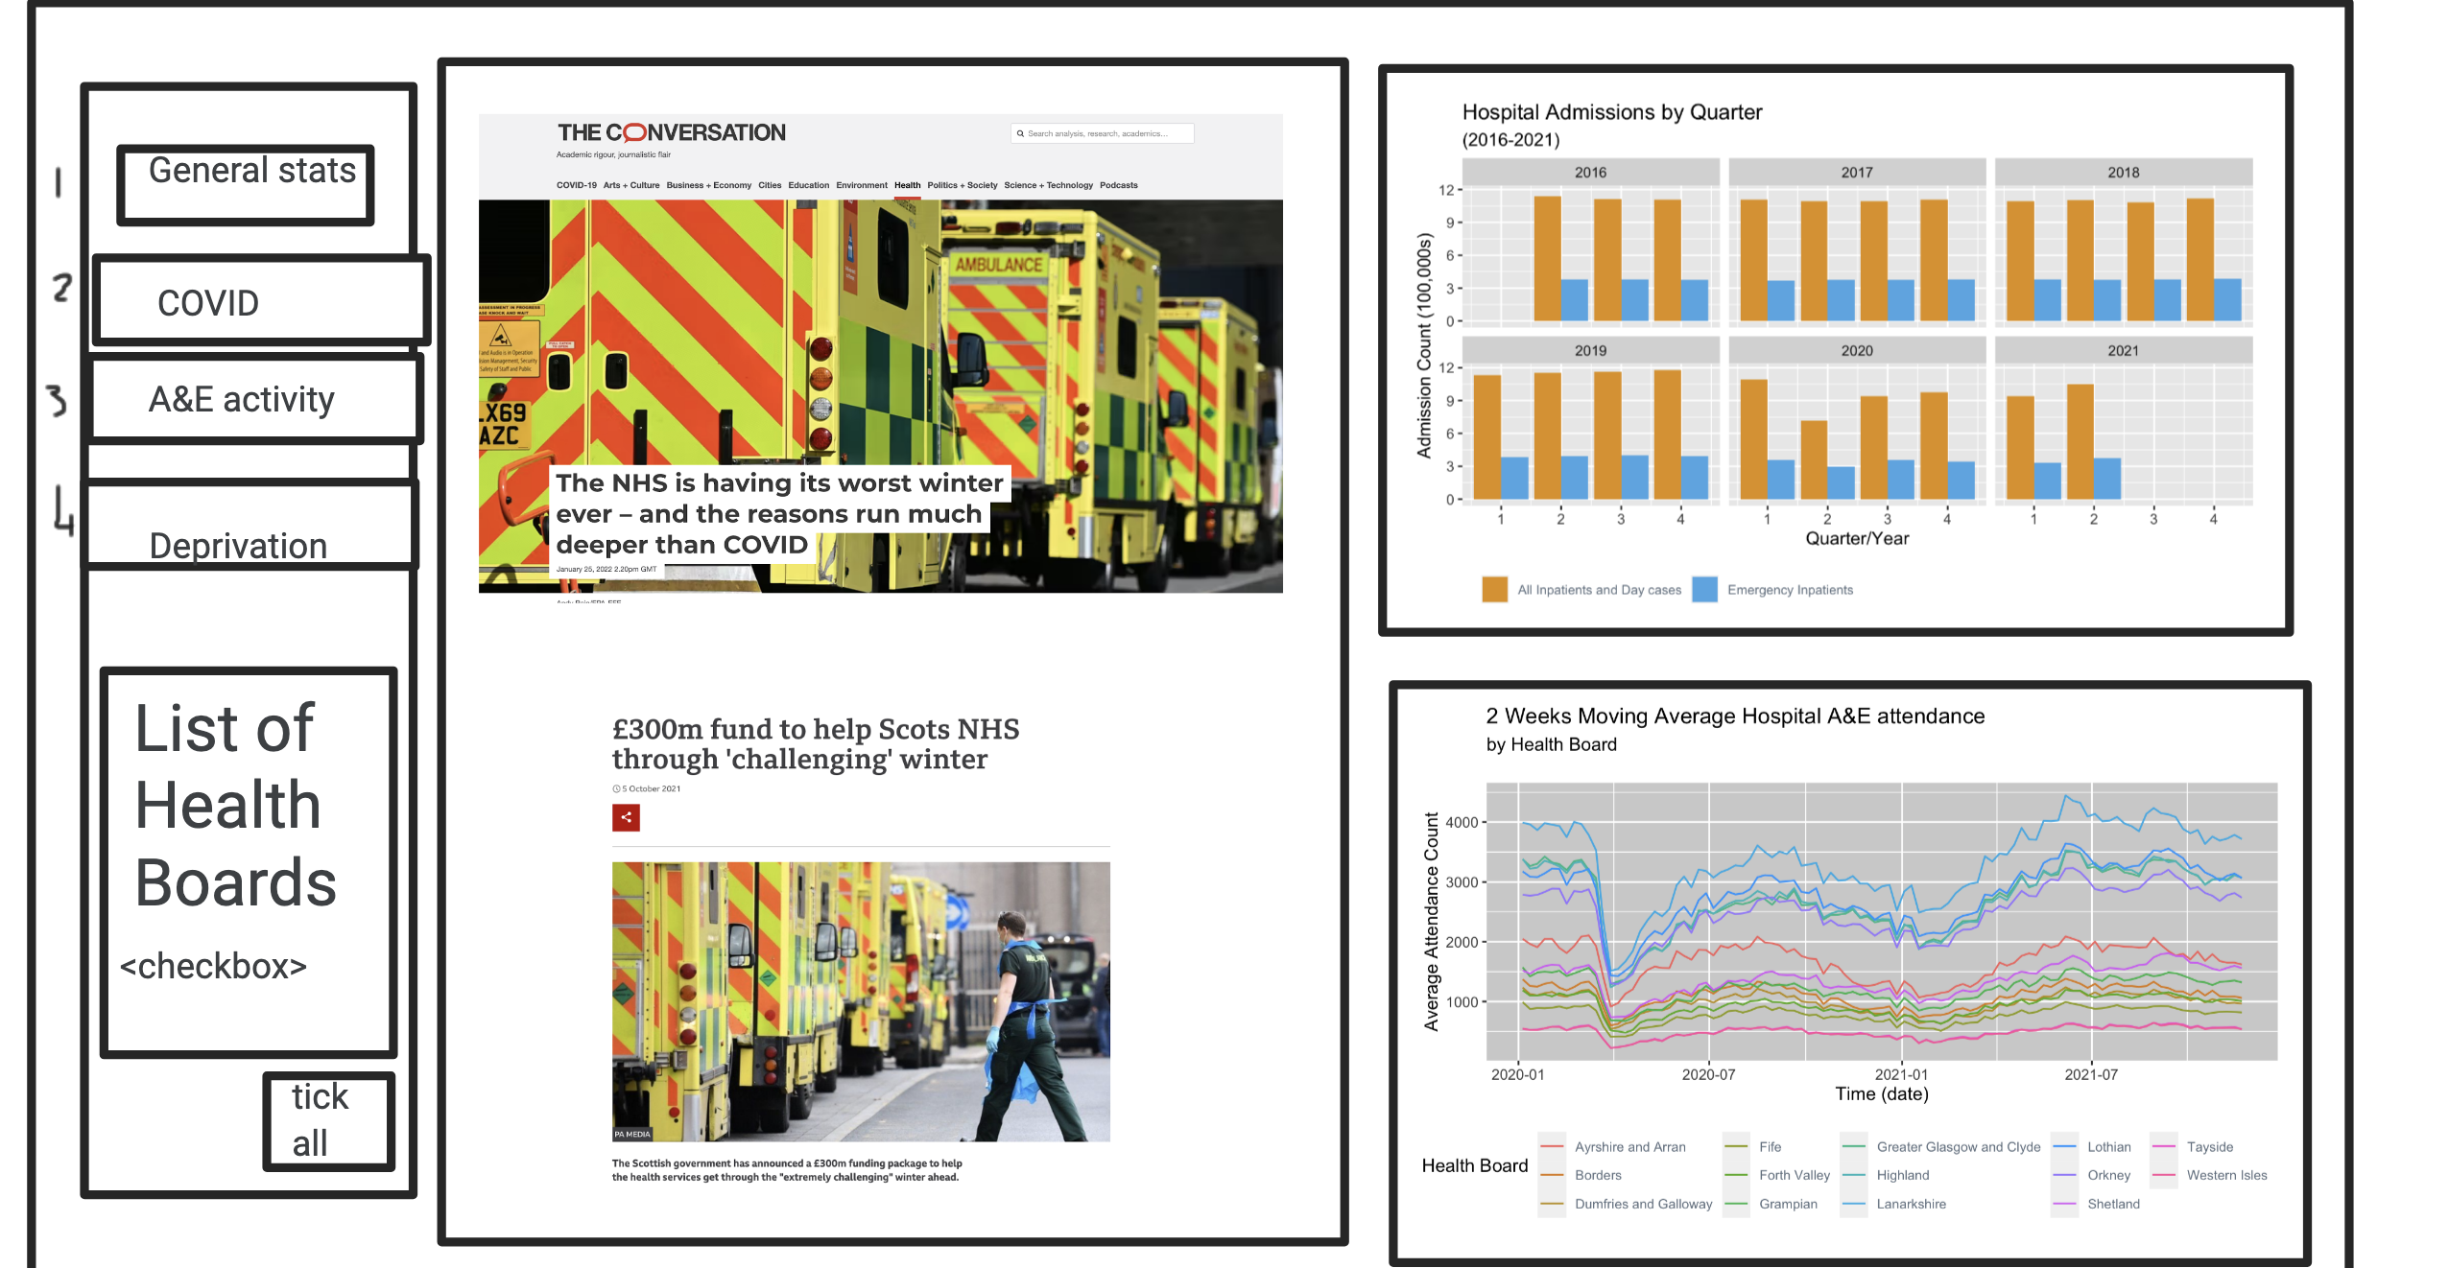

Winter Affectations Post-2020 on Scottish Health Service Application
…from Jamboard wireframes to a Shiny App

Slide 11
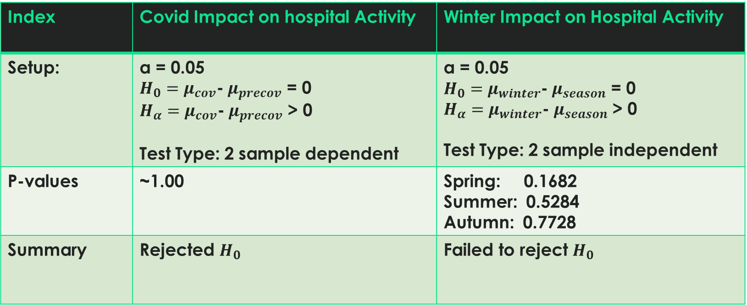
results
Index | Covid Impact on hospital Activity | Winter Impact on Hospital Activity
Setup: | α = 0.05 $H_{0}=μ_{cov}$-$μ_{precov}$ = 0 $H_{α}=μ_{cov}$-$μ_{precov}$ > 0 Test Type: 2 sample dependent | α = 0.05 $H_{0}=μ_{winter}$-$μ_{season}$ = 0 $H_{α}=μ_{winter}$-$μ_{season}$ > 0 Test Type: 2 sample independent
P-values | ~1.00 | Spring: 0.1682 Summer: 0.5284 Autumn: 0.7728
Summary | Rejected $H_{0}$ | Failed to reject $H_{0}$

Slide 12
The ENd
Any questions?

